Slide 1



VOLTORB - SEPTEMBER
Digital Clock

Slide 2

Problem statement
Eddie, Norby and Veeko kidnapped Baby Bink, and we all know how that ended. In short, their venture landed them in prison. In order to escape from prison, they need a bunch of supplies. They have a chisel and a tool set, they have food and water in case it takes too long. The only hurdle is in escaping the guard outside. They cannot see where the guard is from inside. But they have outside information that the guard takes a nap at time x (you can choose the time). Unfortunately for them, there is no way of knowing what time it is. Build a digital clock using ICs and other necessary components, and help the inmates keep track of time.
Instructions:
1. Usage of microcontroller is NOT allowed.
2. The clock has to be precise to minutes. You can choose the 12-hour or 24-hour format.
3. The time has to be displayed in hexadecimal system.

Slide 3

STEPS
Pulse generation
Mod-60 counter
Mod-12/Mod-24 counter
This can be done using a 555-timer IC in astable mode.
To count up to 60 minutes. We start from minutes because that is the problem requirement.
The question gives us the liberty to choose the format.

Slide 4

GANG MEMBERS
Pulse generator
Binary Counter
7-segment display
7-segment display decoder/driver
Basic Logic gates

Slide 5
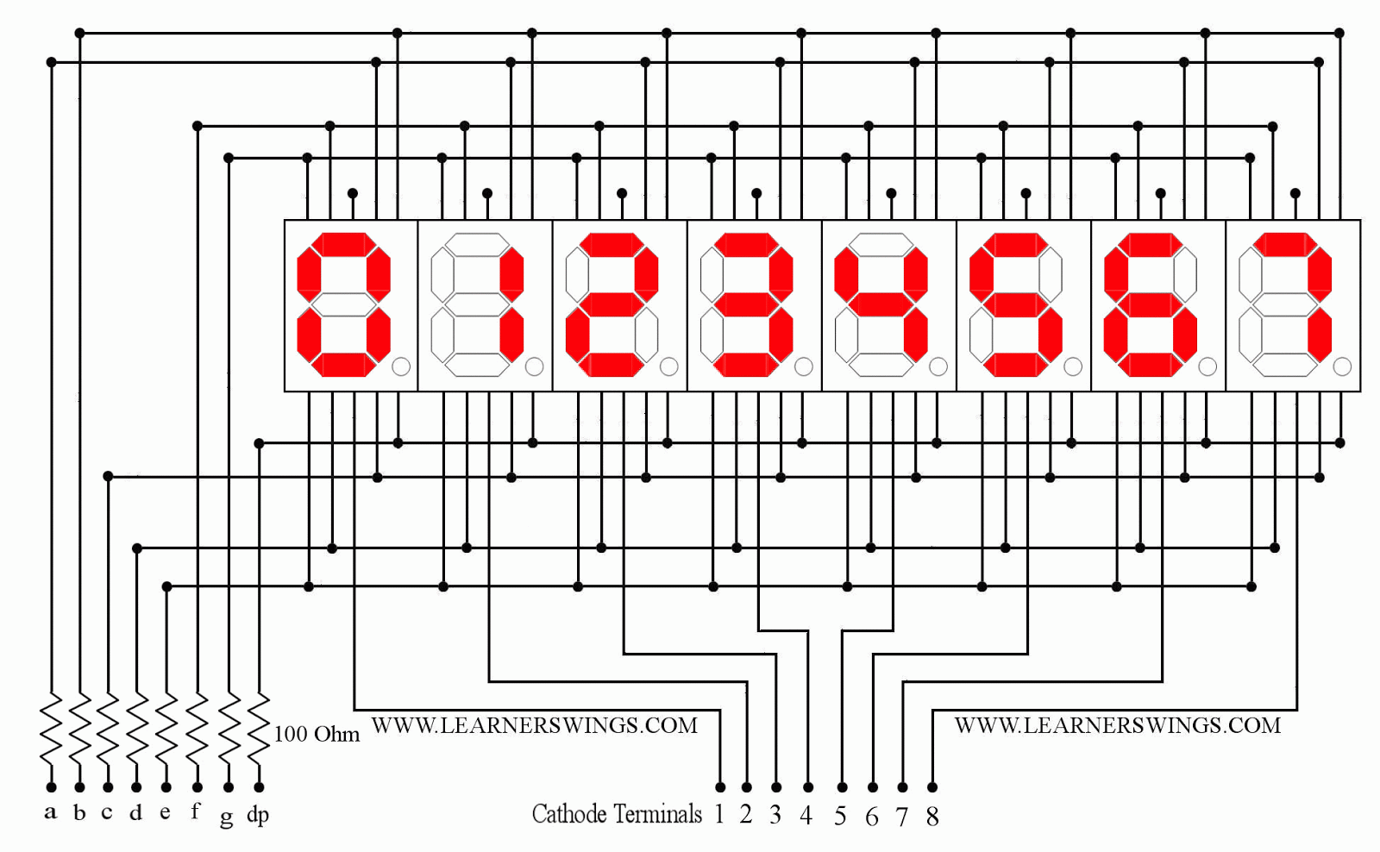

Slide 6



Pulse generation
This can be done using a 555-timer IC in astable mode.

Slide 7
Mod-60 counter
We need a counter that counts from 0-59 for the minutes section, so we use a combination of mod-10 and mod-6 counter here.

Slide 8

Mod-12 counter
For the hours section. A mod-12 counter counts from 0-11 and starts over.
If you choose to use the 24-hour format, you would have to use a mod-24 counter instead.

Slide 9

7-segment: decoder, driver and display
The 7-segment display is used for displaying digits.
Multiple ICs such as 4026, 4511 etc can be used as decoder/driver. The purpose of these is to decode the binary input from the counter into decimal and drive the 7-segment display to display the decimal number.

Slide 10

Put it all together.
Worked, didn’t it?
No? Check connections, check IC inputs and outputs.
Still no? Try using a replacement IC/different method of pulse generation.

Slide 11

How would you do the same with a microcontroller?

Slide 12



Slide 13

IT IS NOW COMPLETE.
Eddie, Norby and Veeko have been successful in their prison break. Baby Bink better be on a lookout!

